Slide 1
CSE520 Project Final Demo Real-time Scheduling Evaluation
Yitong Ding, Bojun Li, Ziwei Zhao
11/30/2015

Slide 2
What we’ve done
Timing API Study
Compare clock_gettime() and gettimeofday
Realize rdtsc() in Raspberry Pi
Scheduling Latency Measurement
Analyze the factors influencing real time latancy
Idle
I/O Bound
CPU Busy

Slide 3
What we’ve done
Worst Case Execution Time Measurement
Measure the WCET of benchmark on pi in different system environment
Idle system
CPU busy system
Cache busy system
I/O busy system

Slide 4
Timing API

Slide 5
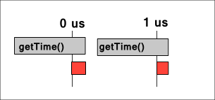
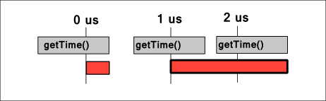
Why do not choose clock_gettime()

Slide 6
Comparison

Slide 7
We need rdtsc()
Time got from rdtsc() is much more accurate
No system call
No math around to fill the structure
However, there is no rdtsc() in Raspberry Pi
Let’s create it ourselves!

Slide 8
Emulate rdtsc() in Pi
Two ways to realize rdtsc in pi
Get direct tick
Read ticks directly from System Timer
Loadable Kernel Module
Extend base kernel to add support for rdtsc
Need assembly language

Slide 9
Emulate rdtsc() in Pi
The easiest way is to open /dev/mem and map the system clock
Base physical address: 0x20003000
Offset | Name | Description
+0x00 | CS | System Timer Control and Status
+0x04 | CLO | System Timer Counter Lower 32 bits
+0x08 | CHI | System Timer Counter Upper 32 bits
+0x0C | C0 | System Timer Compare 0; corresponds to IRQ line 0
+0x10 | C1 | System Timer Compare 1; corresponds to IRQ line 1
+0x14 | C2 | System Timer Compare 2; corresponds to IRQ line 2
+0x18 | C3 | System Timer Compare 3; corresponds to IRQ line 3

Slide 10
Emulate rdtsc() in Pi
volatile long long int *timer_api;
timer_api = (long long int *)((char *)TIMER_map + 4);
Example
Starttime = *timer_api;
………
Endtime = *timer_api;
Execution time = Starttime – Endtime;

Slide 11
Comparison

Slide 12
Scheduling Latency Measurement

Slide 13
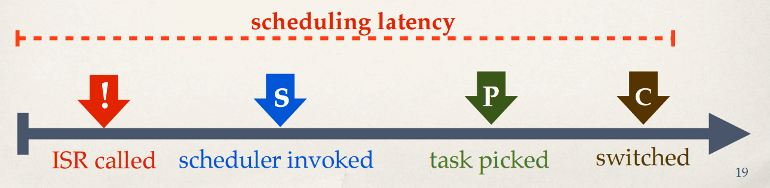
Scheduling latency
Time until the highest priority task is executed
Evaluate with Cyclictest.
From interrupt to context switch

Slide 14
Test Loop on Cyclictest
set interval;
clock_gettime(&now);
next = now + interval;
While(!shutdown)
{
clock_nanosleep((&next));
clock_gettime((&now));
diff = now – next;
}
Interval : Period of the task
Suppose interval = 1000 (us)
Tasks released at 0 1000 2000 3000 …(&next)
Tasks executed at 50 1040 2045 3055 …(&now)
Scheduling latency = now – next;
=50 40 45 55
sudo ./cyclictest -p 98 - m -c 0 -i 500 -n -h 500 -q -l 50000 > results.txt
Priority 98
Interval 500us
Stop after 50000 loops

Slide 15
Scheduling Latency under different scenarios
Idle (no background tasks)
CPU-busy
I/O-busy

Slide 16
Idle system(no background tasks)
How to emulate an idle system?
No graphic interface
No HDMI
No mouse, no Ethernet cable
Eliminate interrupts
Only a keyboard

Slide 18
Idle system(no background tasks)
Represents a best-case scenario
Gets baseline results

Slide 19
CPU-busy system
SQRT: generate an infinite loop of calculation
while (1)
{
a = sqrt(a);
}
Cachebench: cache-intensive workload generator
./sqrt & ./cachebench &./cyclictest

Slide 22
CPU-busy system
Expected to have worsened Latency than an idle system
more cache miss (cache-busy)
more context switch (CPU-busy)

Slide 23
I/O busy system
Hackbench&Netperf
hackbench: causing frequent system calls and scheduler invocations
netperf: generate network data transfer
generate lots of I/O interrupts

Slide 26
I/O busy system
Scheduling Latency is severly affected by I/O tasks.

Slide 27
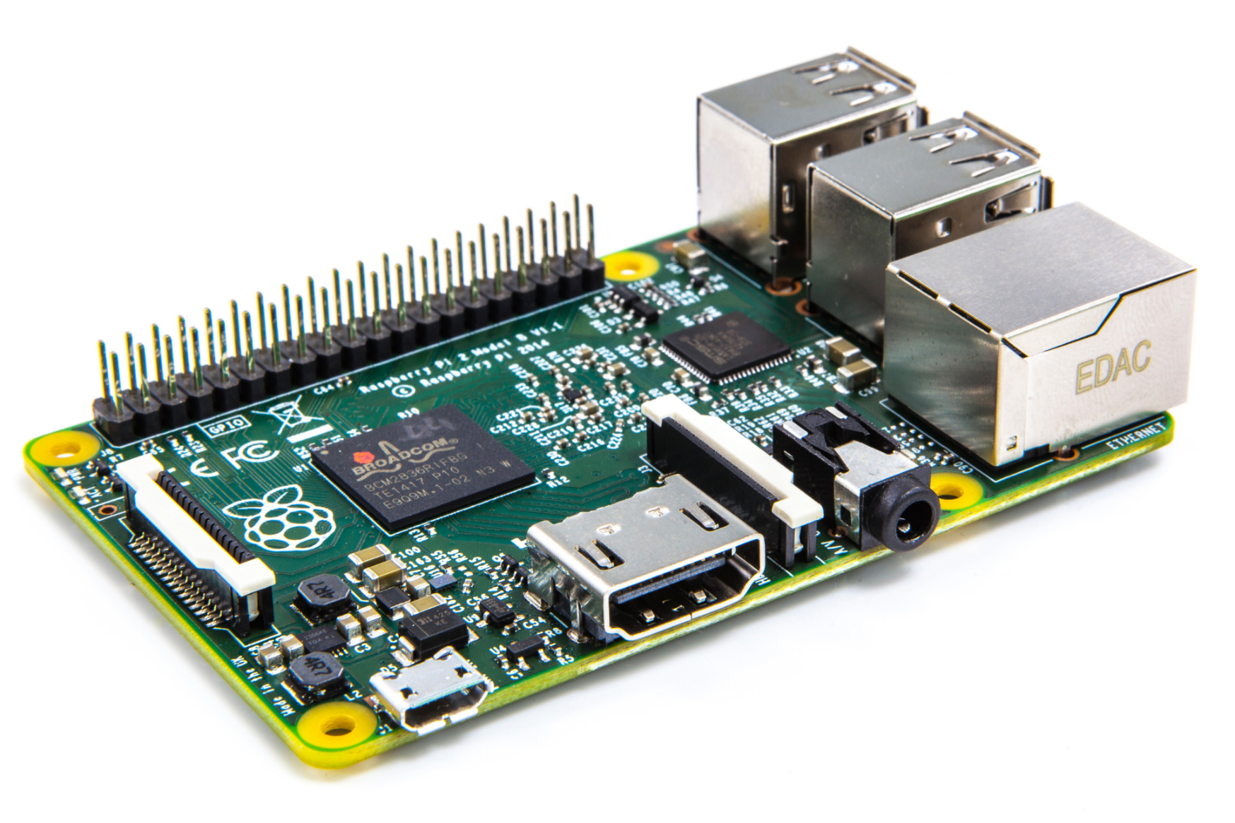
Multi-core scheduling latency research
Raspberry pi 2
quad-core ARM Cortex-A7 CPU
1GB RAM

Slide 28
Multi-core scheduling latency research
Taskset : set or retrieve the CPU affinity
taskset -c X - p 12345
Set the processor affinity of process 12345 to processor #X
CPU0: Avg:18 Max:599
CPU1: Avg:17 Max:56
CPU2: Avg:17 Max:40
CPU3: Avg:17 Max:38

Slide 29
Multi-core scheduling latency research
/proc/interrupts
CPU0 CPU1 CPU2 CPU3
16: 0 0 0 0
20: 1410 0 0 0
32: 4390679 0 0 0
49: 0 0 0 0
50: 0 0 0 0
65: 25 0 0 0
66: 2 0 0 0
75: 1 0 0 0
77: 126 0 0 0
83: 5 0 0 0
84: 11390 0 0 0
96: 0 0 0 0
Most of the interrupts go to CPU0

Slide 30
WCET Measurement

Slide 31
Benchmark
Sqrt() – Forces on floating point calculation
for (i = 0; i < 2000; i++)
temp = sqrt((double)i*i);

Slide 32
Test configuration
At high priority (98)
With period of 100 ms
Run for 10 second
Gather 100 samples
Repeat for 3 times

Slide 33
Test environment
Idle system
CPU busy system
generated by infinite loop of sqrt().
Cache busy system
generated by cachebench.
I/O busy system
generated by netperf.

Slide 34
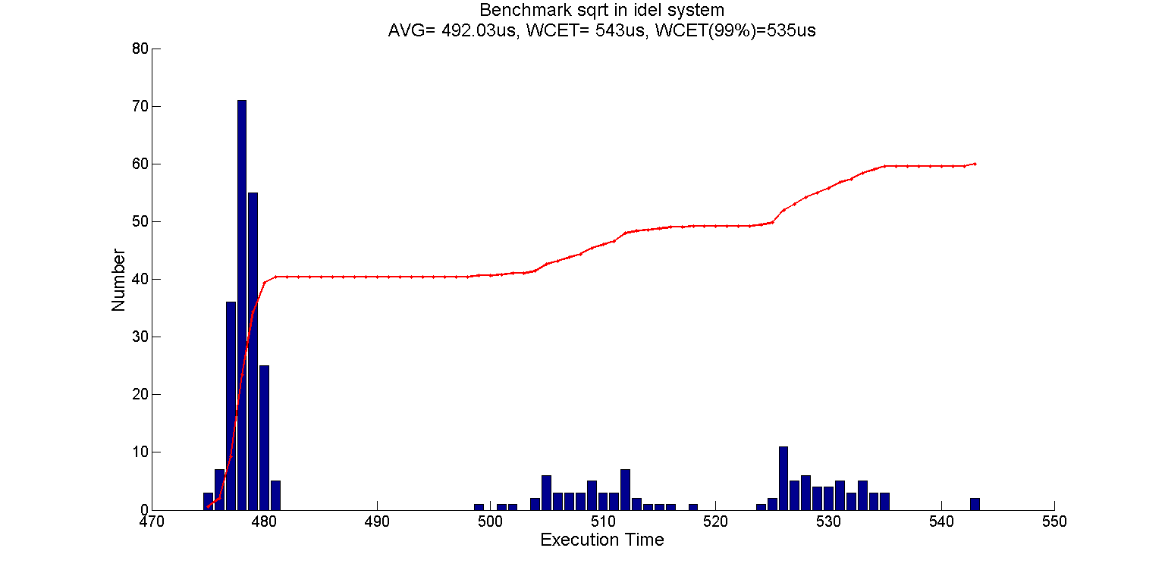
Sqrt() in idle system

Slide 35
Possible interference
1. init
2. ifplugd
3. ntpd
4. rcu_preempt
5. kworker
6. ksoftirpd
7. etc.
Notes:
1.In Unix-based computer operating systems, init (short for initialization) is the first process started during booting of the computer system. Init is a daemon process that continues running until the system is shut down.
2. ifplugd is a daemon which will automatically configure your ethernet device when a cable is plugged in and automatically unconfigure it if the cable is pulled.
3. The ntpd program is an operating system daemon which sets and maintains the system time of day in synchronism with Internet standard time servers.
4. RCU is a synchronization mechanism that is optimized for read-mostly situations. The basic idea behind RCU is to split updates into "removal" and "reclamation" phases.
5. "kworker" is a placeholder process for kernel worker threads, which perform most of the actual processing for the kernel, especially in cases where there are interrupts, timers, I/O, etc. These typically correspond to the vast majority of any allocated "system" time to running processes. It is not something that can be safely removed from the system in any way
6. ksoftirqd is a per-cpu kernel thread that runs when the machine is under heavy soft-interrupt load. Soft interrupts are normally serviced on return from a hard interrupt, but it's possible for soft interrupts to be triggered more quickly than they can be serviced. If a soft interrupt is triggered for a second time while soft interrupts are being handled, the ksoftirq daemon is triggered to handle the soft interrupts in process context. If ksoftirqd is taking more than a tiny percentage of CPU time, this indicates the machine is under heavy soft interrupt load.

Slide 36
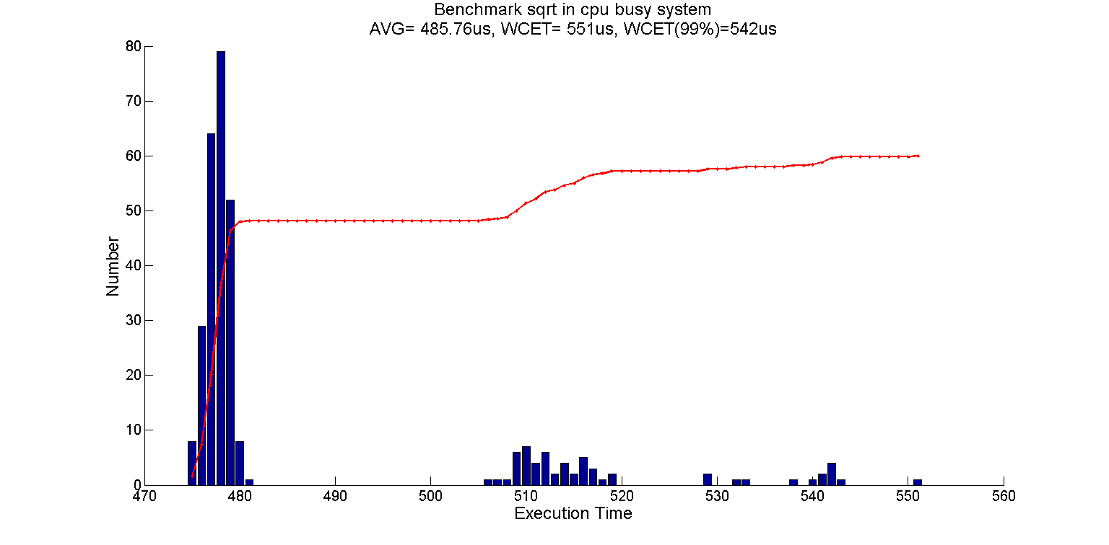
Sqrt() in cpu busy system

Slide 37
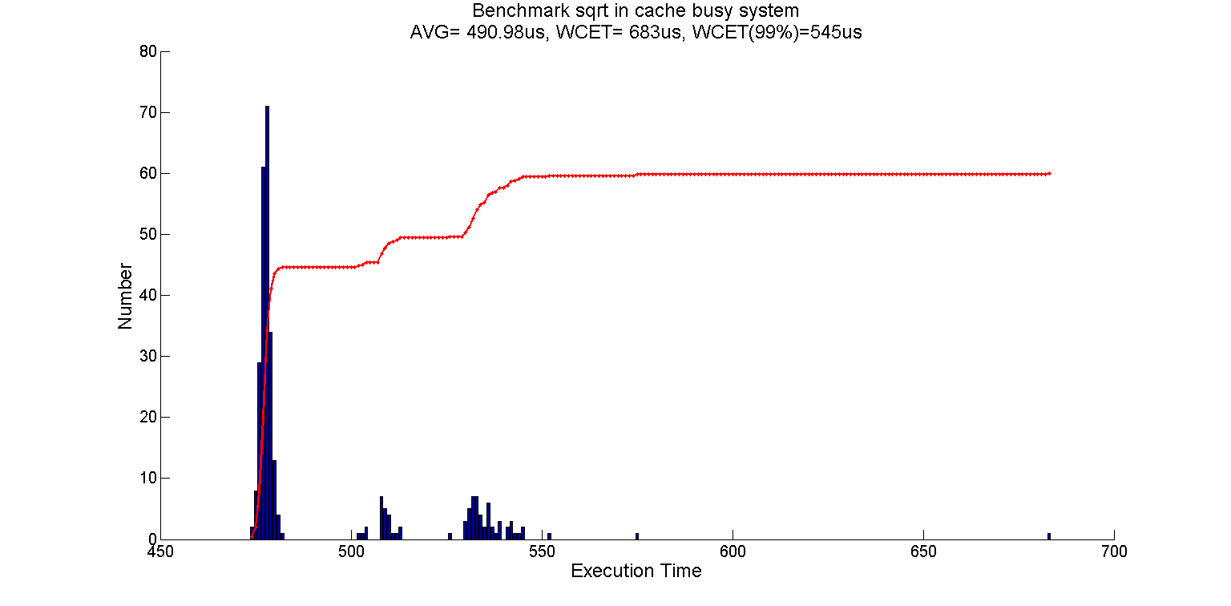
Sqrt() in cache busy system

Slide 38
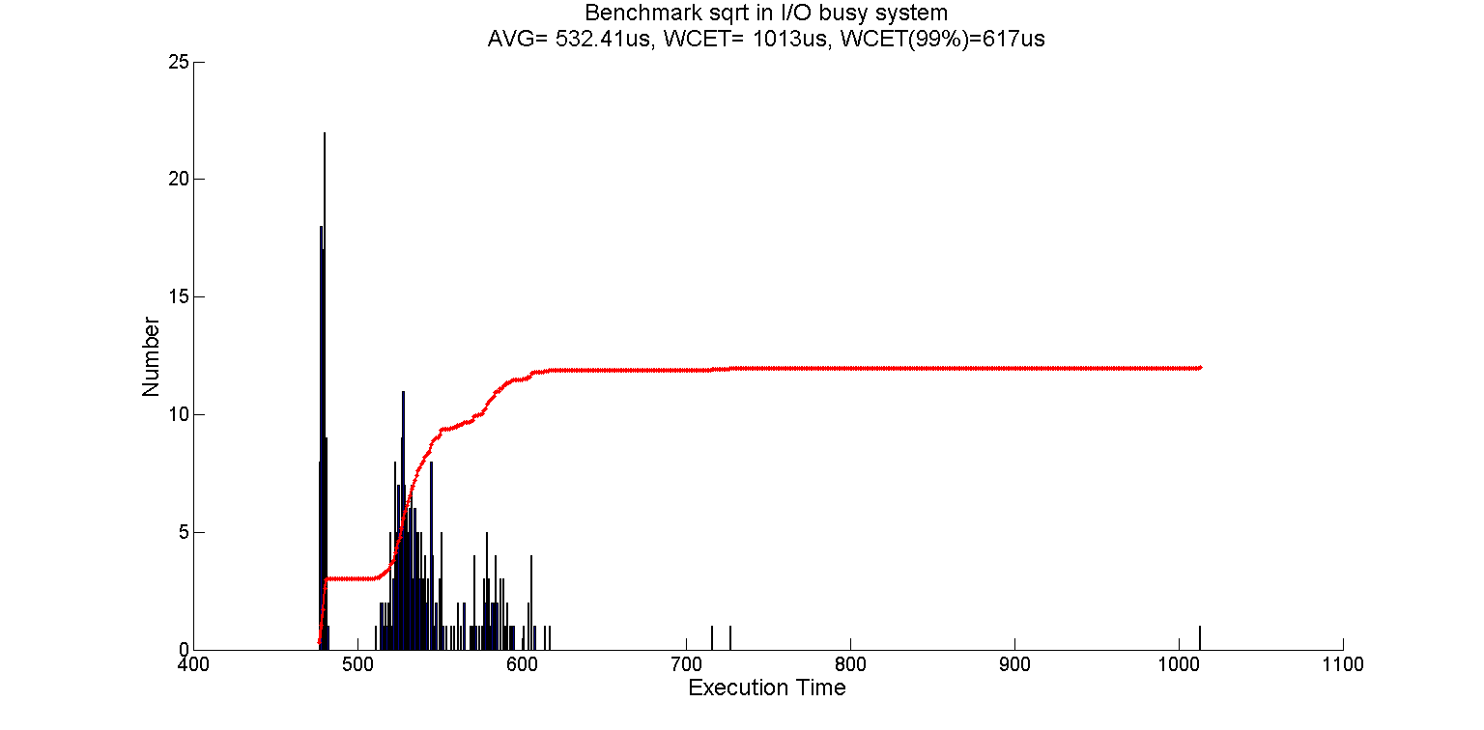
Sqrt() in I/O busy system

Slide 39
Summery for sqrt()
Time in us | Idle | CPU Busy | Cache Busy | I/O Busy
Average | 492 | 486 | 491 | 532
WCET(99%) | 535 | 542 | 545 | 617
WCET | 543 | 551 | 683 | 1013

